Slide 1


Hackathon Overview &
Rules and Regulations
An overview of the key stages of a hackathon, key Slack channels, and regulations for a fair competition.

Slide 2
Table of Contents
Slide No. | Slide Contents
3 | What is a Hackathon?
4 | Working with Slack
7 | Stages of Development
12 | Team Forming, Norming and Storming
17 | Rules & Regulations - Eligibility and Submissions
21 | Rights and Ownership
23 | Code of Conduct
24 | More Questions?

Slide 3

What is a Hackathon?
A hackathon is best described as an “invention marathon” by Major League Hacking (MLH). According to them: Anyone who has an interest in technology attends a hackathon to learn, build & share their creations over the course of a weekend in a relaxed and welcoming atmosphere. You don’t have to be a programmer and you certainly don’t have to be majoring in Computer Science.
In a nutshell, teams are given between 24 and 72 hours to develop a project from scratch, demo it to judges, and win prizes! Think software development from development to deployment, in the span of one weekend!

Slide 4

Working with Slack
Primarily relevant to Mentors, Competitors, Judges, Partners & Volunteers

Slide 5
Slack to communicate
Slack Profile
We use Slack to facilitate communication between team members of the same team, different teams, mentors, sponsors, organizers, etc.
We’ll be opening up the Slack space up a week early, so get in quick to mingle like your single and introduce yourself, share resources, find teammates, join existing teams and idea generate . We’ll be updating you in #announcement channel on challenge releases and also be running workshops in parallel so you have all the information you need to be ready.
Filling out your slack profile will be to your advantage in being found or even trusted once found. In some cases, a full profile is mandatory. Ensure your full name, profile picture (headshot is best practice) and Bio is filled in that includes your background, skillsets and the problems you are interested in solving. You might also like to include whether you have joined an existing team or are looking for a new one.

Slide 6
Slack Channels for everyone
There are default channels common for all (as shown below) and specific channels for teams, mentors and challenges. Familiarize yourself with all of them before the Hackathon so you never miss an announcement or update!
Key Channels
#announcements: This is one of the most important channels. Make sure to check this regularly (we recommend at least twice per day) for real time live communication and updates from organisers.
#Intros: Let us know who you are, your special talents, where are you from and why are you here
#water_Cooler: A fun channel that people can use for banter, camaraderie and anything else that fancies them.
#Resources: Resources or data sets related to hackathon or challenges.
#presentation_tips: For mentors who wanted to offer pitch support, online tools to help with their final pitches and Youtube videos
#ask_the_organisers: 4 key organisers monitored this channel for general QA

Slide 7

Stages of Development
Primarily relevant to Mentors & Participants

Slide 8
Stages of Development
In a workplace environment, the stages of software development typically take 5 steps
Planning
Design
Implementation
Testing
Maintenance
In a Hackathon, due to the time constraint, the development process for most teams will end up looking like this:
Idea generation
Rapid build
Demo
The Hackathon approach, allows for laboratories of experimentation to have the speed and time pressure to address urgent needs if it develops into a standalone solution.

Slide 9

Idea Generation
For the first few hours of the hackathon, many things will be happening while hackers get settled in to start hacking.
When it comes the time for teams to start brainstorm ideas for their hack, this is a great time for mentors to use their industry knowledge to:
Give feedback on their ideas for things like feasibility, usability, and design
Set up development environments such as installing the right IDE or software versions.

Slide 10
Rapid Build
For the bulk of the hackathon, hackers will be hard at work at making their projects come to life.
This hackathon will have a dedicated mentor Slack channel where hackers post their question and location in the hacking space. This way, mentors can choose to help out with what they’re best at!
Note that hackers come from all sorts of skill levels and backgrounds, and helping them may include but are not limited to:
Getting started with new technologies and tech stack
How to use APIs and API authentication
Debugging and troubleshooting
Ongoing feedback on the design and direction that their project is going

Slide 11

Demos and Submission
Towards the end of the hacking period, hackers will start putting together a demo of their projects for judging. Here, a mentor’s industry experience and business insight will be especially valuable at this time to help hackers build a usable and interesting project:
Beta testing the project and suggesting enhancements, if possible
Giving feedback on giving an engaging and interesting demo
Deployment and DevOps help
More debugging and troubleshooting

Slide 12
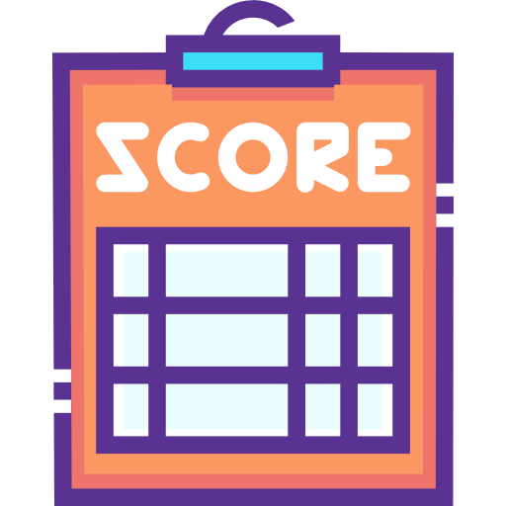
Team Forming, Norming & Storming
Primarily relevant to Competitors

Slide 13
Overview: What to keep in mind before forming your team
Every success story in such a competition relies on the efforts of the whole team, and as such you need to take care of being an organized and diverse party. In fact, multiple winning teams from our previous hackathons have credited the diverse backgrounds and expertise of their members for their win.
Code is king, obviously, but the fact that many aspects are judged from the visual side needs to be accounted for as well. Even if you don’t have people from those respective backgrounds, it is crucial that tasks are divided and assigned in such a way that the process of developing the project is as optimized as possible.
Presentation of the final product is as important as its development so don’t forget to appoint a member of your team for this task right when you start working.
Looking back on past challenges it is clear that neglecting this element negatively influences the reception of the project.If you are unable to explain your solution or communicate and show its benefits, people may not be able to see its real value.

Slide 14
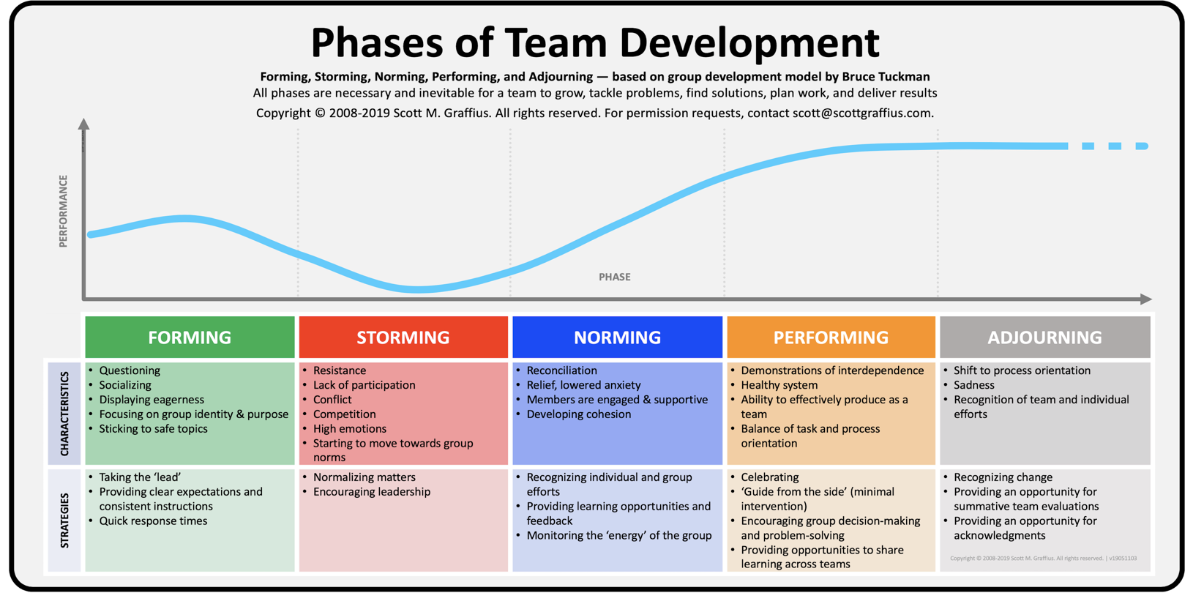
High Res Image available here

Slide 15
A summary framework for each step of the process
Forming
Characteristics of Forming include questioning, socializing, displaying eagerness, focusing on group identity and purpose, and sticking to safe topics. Strategies for this phase include taking the 'lead,' providing clear expectations and consistent instructions, and quick response times
Storming
Traits of Storming include resistance, lack of participation, conflict, competition, high emotions, and moving towards group norms. Strategies for this stage include normalizing matters and encouraging leadership
Norming
Features of Norming include reconciliation, relief, lowered anxiety, members are engaged and supportive, and developing cohesion. Strategies for this phase include recognizing individual and group efforts, providing learning opportunities and feedback, and monitoring the 'energy' of the group

Slide 16
A summary framework for each step of the process
Performing
Characteristics of Performing include demonstrations of interdependence, healthy system, ability to effectively produce as a team, and balance of task and process orientation. Strategies for this stage include celebrating, 'guide from the side' (minimal intervention), encouraging group decision-making and problem-solving, and providing opportunities to share learning across teams.
Adjourning
Traits of Adjourning include a shift to process orientation, sadness, and recognition of team and individual efforts. Strategies for this phase include recognizing change, providing an opportunity for summative team evaluations, and providing an opportunity for acknowledgments.

Slide 17

Rules & Regulations

Slide 18
Eligibility for Competitors, Teams & Mentors
Both the Hackathon and Project Showcase competitions will have the same eligibility requirements:
Competitors
This Hackathon is open to participants of any gender, industry and age. For any participants below the age of 18, a consent form signed by a relevant guardian will need to be filled.
Mentors
This Hackathon is open to mentors of any nationality, gender, industry and age (above 18 only).
Team size
The recommended team size is 2-6, up to a maximum of 8 members per team.

Slide 19
Assessment of Submissions
In both the Hackathon competition and project showcase, there are two types of eligible solutions:
Option 1: A production-ready solution for immediate impact (e.g. working dashboard, predictive algorithm)
Option 2: Ship an awesome proof-of-concept with lots of potential (e.g. economic model, virus spread simulation)
Both the Hackathon competition and project showcase entries will be judged by the Hackmakers Competition Judging Panel against the following criteria:
Originality
Consistency with hackathon theme
Social value
Quality and design
Usability

Slide 20
Eligible Solution Uploads
As both hackathon projects will be shown on a gallery for public voting, videos will be the primary form for assessment
Video (Compulsory)
Advised to be 2-4 minutes in length, submissions overtime will incur a small penalty.
Videos must be made public or through a private link for judges to assess and Hackmakers to own license for potential distribution.
Document (Optional)
The document should be up to 8 pages in Microsoft Word, public link to Google docs, or PDF to describe your ideas
Able to use charts, diagrams and tables to explain your ideas with any appendix attached
GitHub or other code repo link (Optional)
Provide a publically available

Slide 21
Rights and Ownership
Submissions and their associated intellectual property rights will remain under the sole or joint ownership of their inventor(s). Neither Hackmakers nor its partners can claim any ownership to the IP of the ideation. We encourage participants to open source their projects to both share their hacks with the greater community and to promote innovation in this space.
We, along with all parties involved in the development of the hackathon, reserve the right to use all participating teams’ and/or individuals’ names and likenesses in any publicity statements or events, including internet and website posts or articles, regarding the hackathon or the party’s involvement therewith.
By submitting a Submission, you grant Sponsor irrevocable, royalty-free, non-exclusive, worldwide right and license to use, distribute to the public, and publicly display and perform your Submission in any media, in connection with the hackathon.
Your Submission may be posted on a public website, or through any of Hackmakers’s or respective partner’s existing social media or marketing channels. We are not responsible for any unauthorized use of your Submission by visitors to this website.

Slide 22
Rights and Ownership
You will not receive any compensation or credit for the above use of your Submission, other than what is described in these Official Rules.
By entering the Project showcase competition you acknowledge that Sponsor and/or the co-sponsors or promoters of the Hackathon may have developed or commissioned materials similar or identical to your Submission and you acknowledge and agree that neither Sponsor nor any co-sponsors or promoters has now and will not have in the future any duty or liability (direct or indirect, vicarious, contributory, or otherwise) with respect to the infringement or protection of your or any third party’s patent, copyright or other proprietary rights in and to their content.
Further you understand that we will not restrict work assignments of representatives who have had access to your Submission.
We, along with all parties involved in the development of the hackathon, reserve the right to use all participating teams’ and/or individuals’ names and likenesses in any publicity statements or events, including internet and website posts or articles, regarding the hackathon or the party’s involvement therewith.

Slide 23
Code of Conduct & Additional Terms
We are dedicated to providing a harassment-free hackathon experience for everyone, regardless of gender, gender identity and expression, age, sexual orientation, disability, physical appearance, body size, race, ethnicity, religion (or lack thereof), or technology choices.
We do not tolerate harassment of our participants in any form. Sexual language and imagery is not appropriate for any hackathon venue, including talks, workshops or online media. Conference participants violating these rules may be sanctioned or expelled from the event.
Any mediation of problems between competitors, teams and external parties regarding individual ownership of team ideas, personal disputes etc. will be decided by Hack Makers or nominated partners. All decisions will be final.
By submitting an idea or through being a mentor or judge, you agree that your personal information may be used in the promotion and results of this hackathon either by Hack Makers or third party sponsors.

Slide 24
More questions?
I want to know more about this hackathon:
Hackathon FAQ Quick Guide: https://docs.google.com/presentation/d/1by21Mh4YueRPyNdTgt17tqM5DXdD4LiICG4SGMJUcy4/edit?usp=sharing
I want to be a participant:
Make a new registration as a participant at: www.Hackmakers.com
Read through the Participant Guide: https://docs.google.com/presentation/d/1QUGkvYDqDm0nynxO-1TM3DGmsyzZLKnao-3ID_ARi4M/edit?usp=sharing
I want to know the general rules and regulations:
https://docs.google.com/presentation/d/1l0cdM_6tacrpiHgCyU6g039THDrSuuEB2fypcgnUShI/edit?usp=sharing

